Slide 1
Projection
The act of obtaining the image of an object is called projection.
In professional drawing, 3-dimensonal objects are represented graphically on a 2-dimensional media which is known as projection.

Slide 2
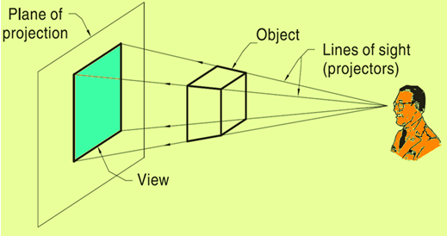
Requirements of Projection
Object
Observer
Lines of sight (Projectors)
Plane of Projection (Screen)

Slide 3
Projection Types
The type of projection is based on the combination of two variables:
1) Line of sight (Projectors)
2) Plane of projection (image plane or picture plane)

Slide 4
Line of sight is an imaginary ray of light between an
observer’s eye and an object.
There are 2 types of LOS :
parallel
and
converge
Parallel
Perspective
Line of sight
Line of sight

Slide 5
Plane of projection is an imaginary flat plane on which
the image is created.
The image is produced by connecting the points where
the LOS pierce the projection plane.
Parallel
Perspective
Plane of projection
Plane of projection

Slide 6
Methods of Projection
In Engg. Drawing four most common methods of projection (Based on LOS and POP) used are:
Orthographic
Oblique
Isometric
Perspective

Slide 7
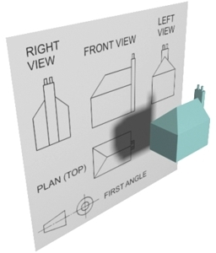
What is Orthographic Projection?
Orthographic Projection is a method of representing a three dimensional object on paper using several two dimensional orthographic views.
It is the international language of Engineers and Designers

Slide 8
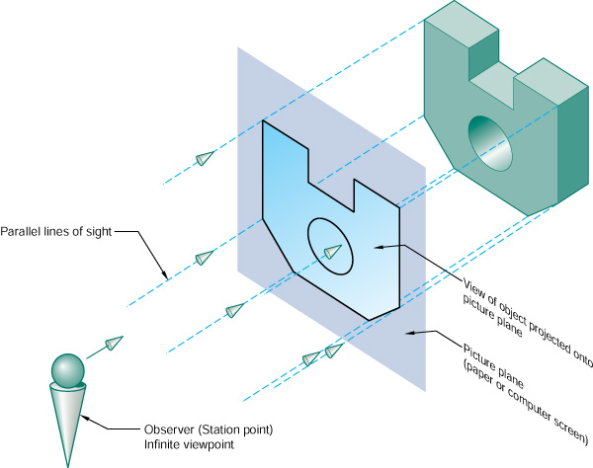
How does it work?
We look directly at the different faces of the object (90˚ to the face) and draw the lines that we see.

Slide 9
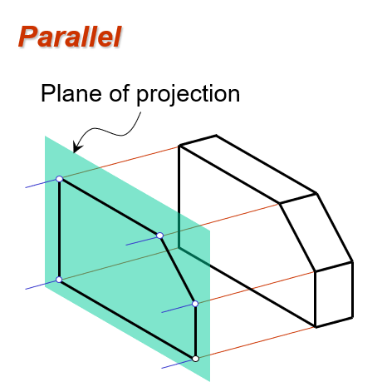
LOS are parallel to each other
LOS are perpendicular to POP and Object surface.

Slide 10
Isometric Projection
Isometric projection corresponds to rotation of the object by ± 45° about the vertical axis, followed by rotation of approximately ± 35.264° about the horizontal axis starting from an orthographic projection view.

Slide 11
In isometric projection
LOS parallel to each other
LOS are perpendicular to POP

Slide 12
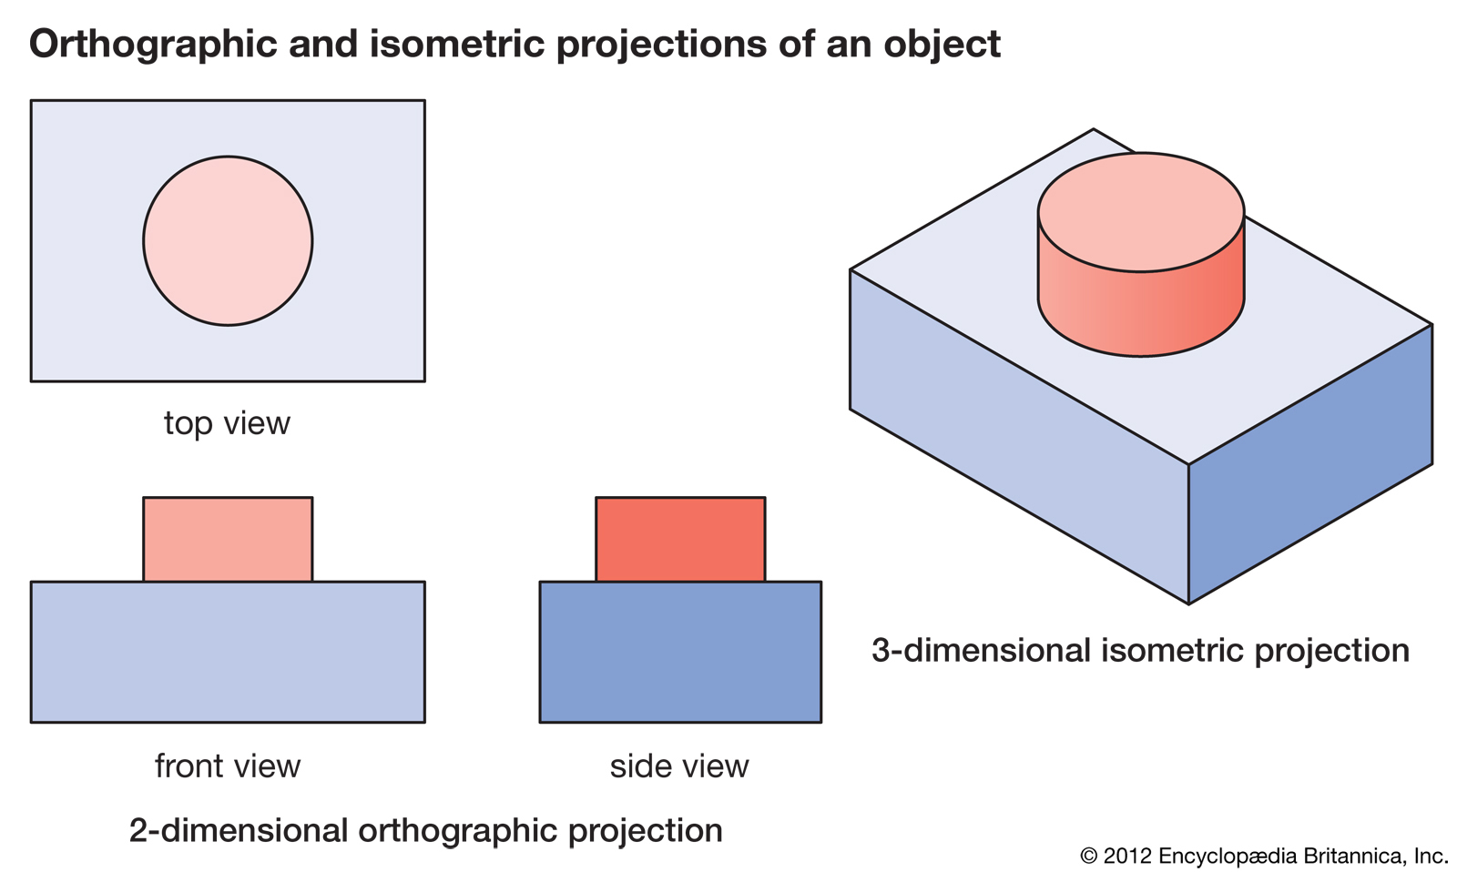

Slide 13
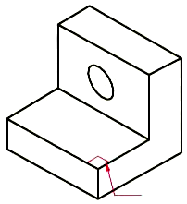
Isometric Drawing
Advantage
Easy to understand
Disadvantage
Shape and angle distortion
Example
Distortions of shape and size in isometric drawing
Circular hole becomes ellipse.
Right angle becomes obtuse angle.

Slide 14
PROJECTIONS OF POINTS
GENERAL CONVENTIONS
  The actual point in space is annotated as an upper case letter.
  The front view is annotated as a lower case letter with a prime and the top view as a lower case letter without a prime, e.g., if the actual point is ‘A’ then its Front View is marked as a´ and its Top view is marked with a.
  The intersection of the two principal planes, i.e., the Horizontal Plane (H.P.) and the Vertical Plane (V.P.), is a straight line known as the reference line and shall be annotated as the xy line.

Slide 15
PROJECTIONS OF POINTS
  A point can be situated anywhere in the three dimensional space relative to the two planes of projection.
  The point can be either above, below or within the H.P.
  The point can be either in front of, behind or within the V.P.
  With Reference to H.P. With Reference to V.P.
  Above In Front
  Below Behind
  Within Within

Slide 16
With Reference to H.P. With Reference to V.P.
  Above In Front
  Below Behind
  Within Within
  Nine possible positions with respect to the two reference planes.
    Above the H.P. & In Front of the V.P. (1st Angle)
    Above the H.P. & Behind the V.P. (2nd Angle)
    Above the H.P. & Within the V.P. (Boundary of 1st and 2nd Angle)
    Below the H.P. & In Front of the V.P. (4th Angle)
    Below the H.P. & Behind the V.P. (3rd Angle)
    Below the H.P. & Within the V.P. (Boundary of 3rd and 4th Angle)
    Within the H.P. & In Front of the V.P. (Boundary of 1st and 4th Angle)
    Within the H.P. & Behind the V.P. (Boundary of 2nd and 3rd Angle)
    Within the H.P. & Within the V.P. (In the Reference Line)

Slide 17
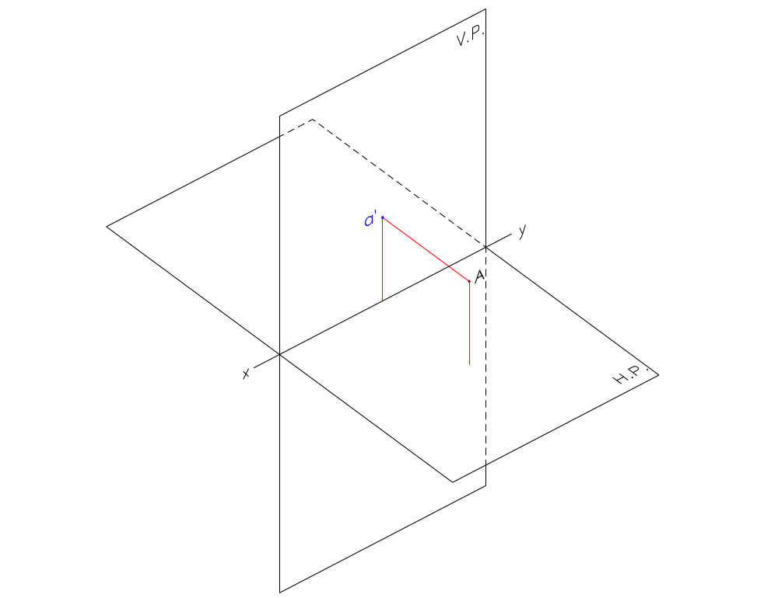
  Point Above the H.P. and In Front of the V.P.
    Front View is drawn Above the xy.

Slide 18
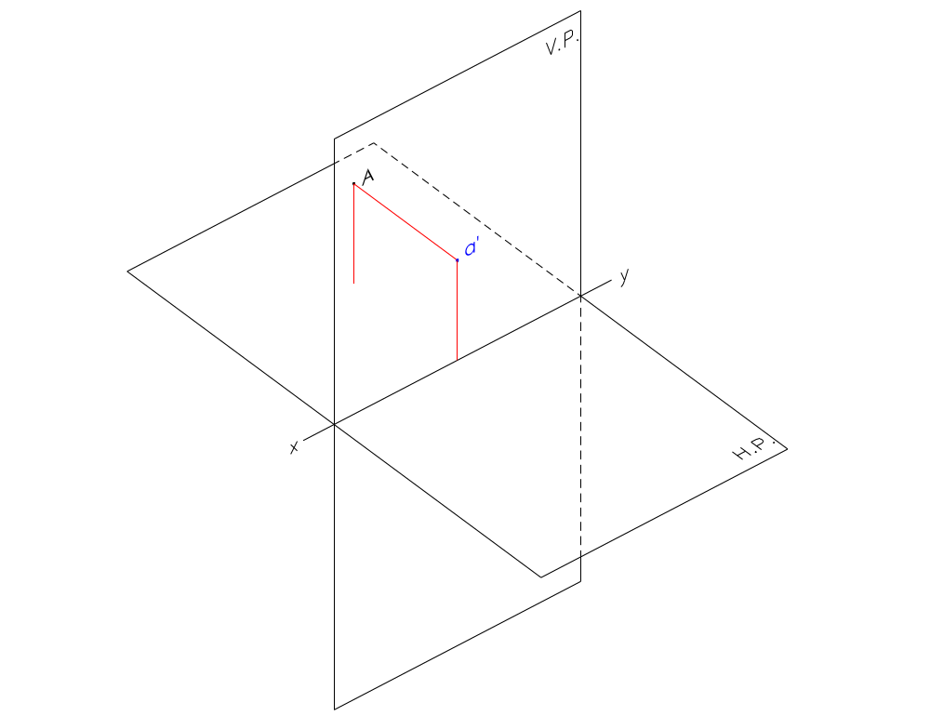
  Point Above the H.P. and Behind the V.P.
    Front View is drawn Above the xy.

Slide 19
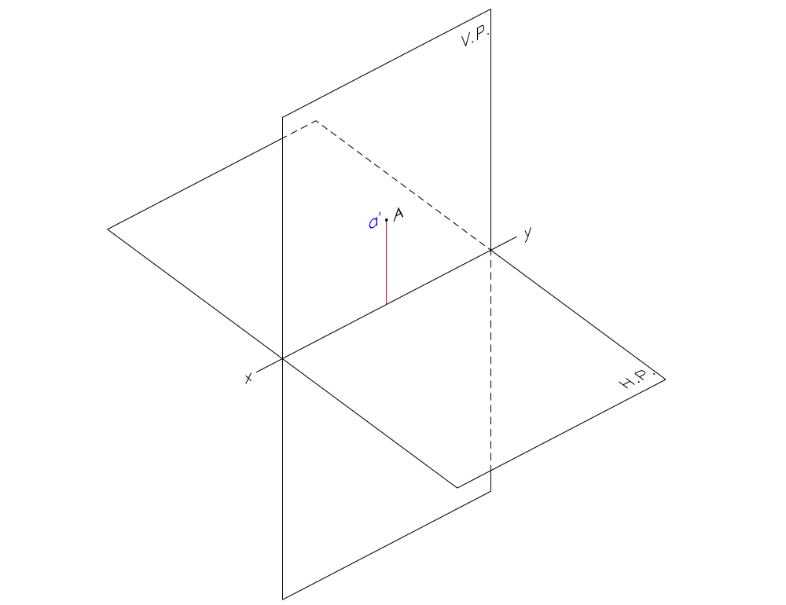
  Point Above the H.P. and Within the V.P.
    Front View is drawn Above the xy.

Slide 20
If a point is ABOVE the H.P.;
Its Front View is always ABOVE xy.

Slide 21
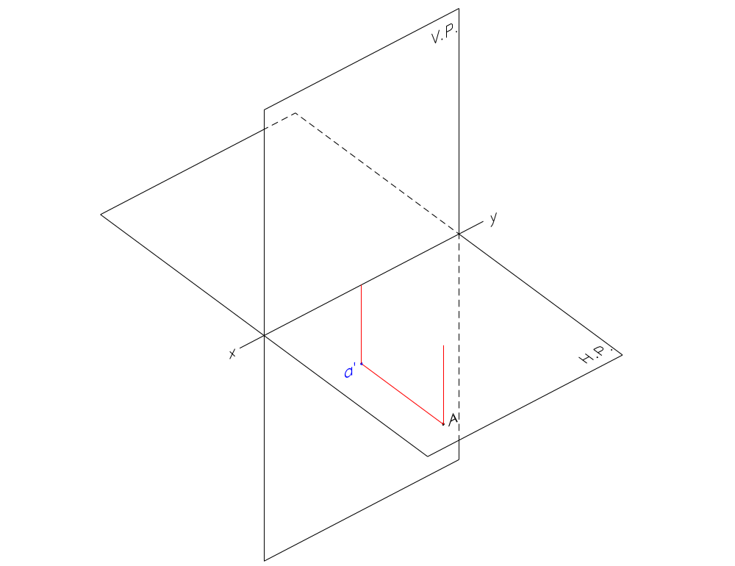
  Point Below the H.P. and In Front of the V.P.
    Front View is drawn Below the xy.

Slide 22
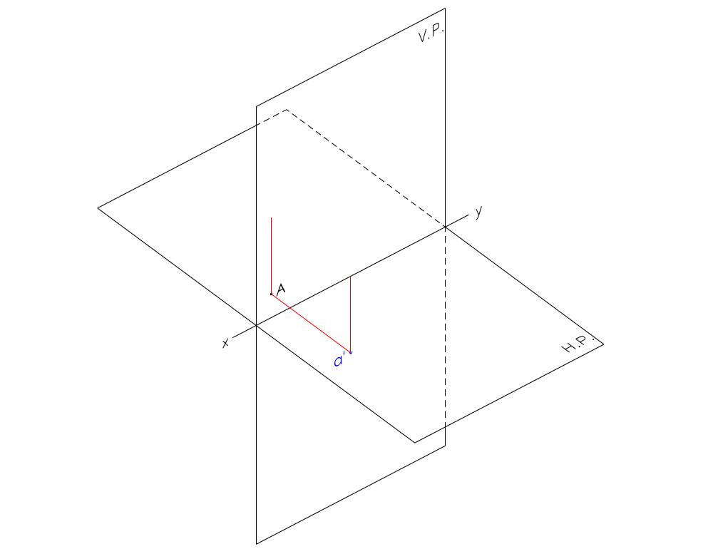
  Point Below the H.P. and Behind the V.P.
    Front View is drawn Below the xy.

Slide 23
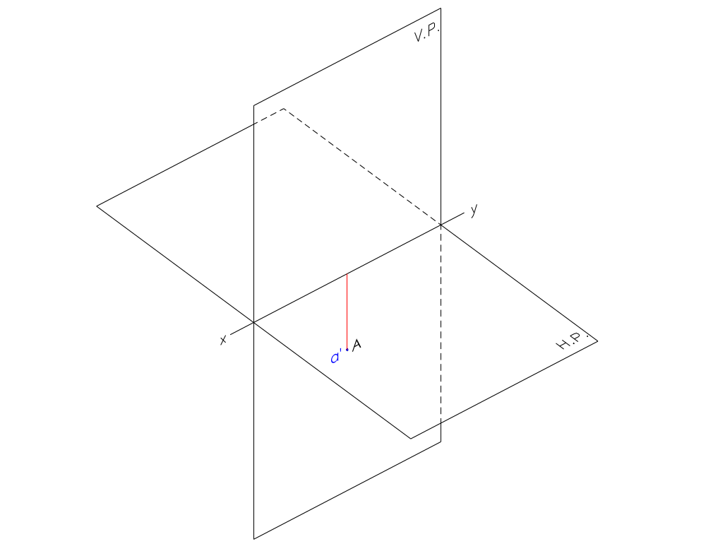
  Point Below the H.P. and Within the V.P.
    Front View is drawn Below the xy.

Slide 24
If a point is BELOW the H.P.;
Its Front View is always BELOW xy.

Slide 25
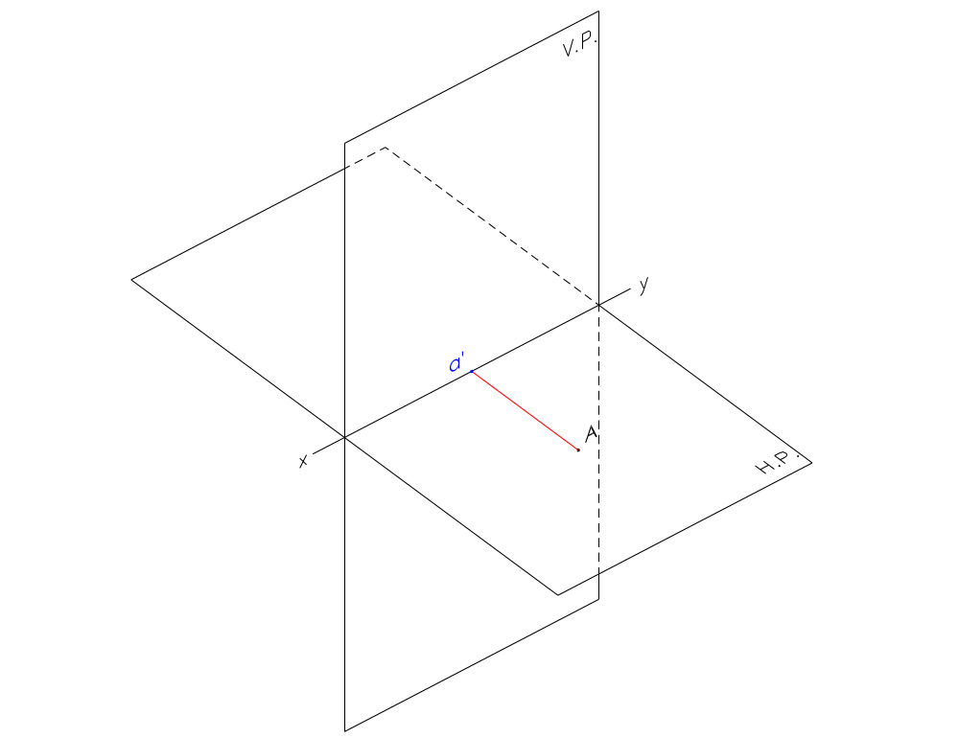
  Point Within the H.P. and In Front of the V.P.
    Front View is drawn In the xy.

Slide 26
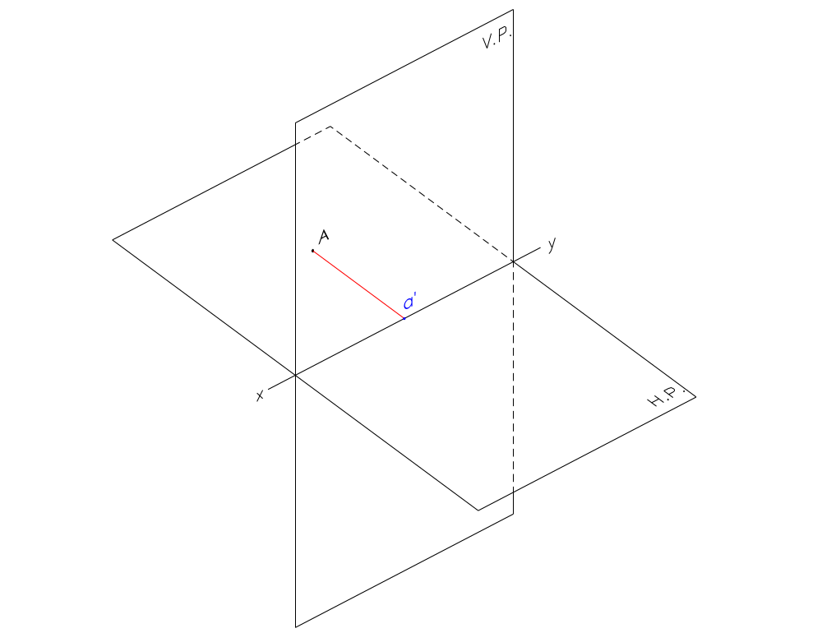
  Point Within the H.P. and Behind the V.P.
    Front View is drawn In the xy.

Slide 27
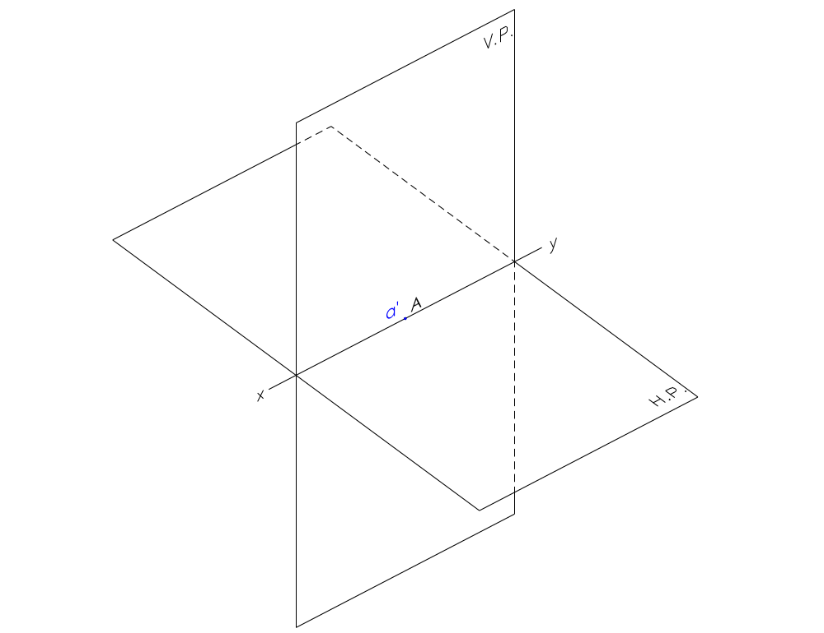
  Point Within the H.P. and Within the V.P.
    Front View is drawn In the xy.

Slide 28
If a point is WITHIN the H.P.;
Its Front View is always IN xy.

Slide 29
The position of the Front View of a point with respect to the xy line is dependent on its position with respect to the H.P.
The distance of the Front View of the point from the xy line is the same as the distance of the point from the H.P.

Slide 30
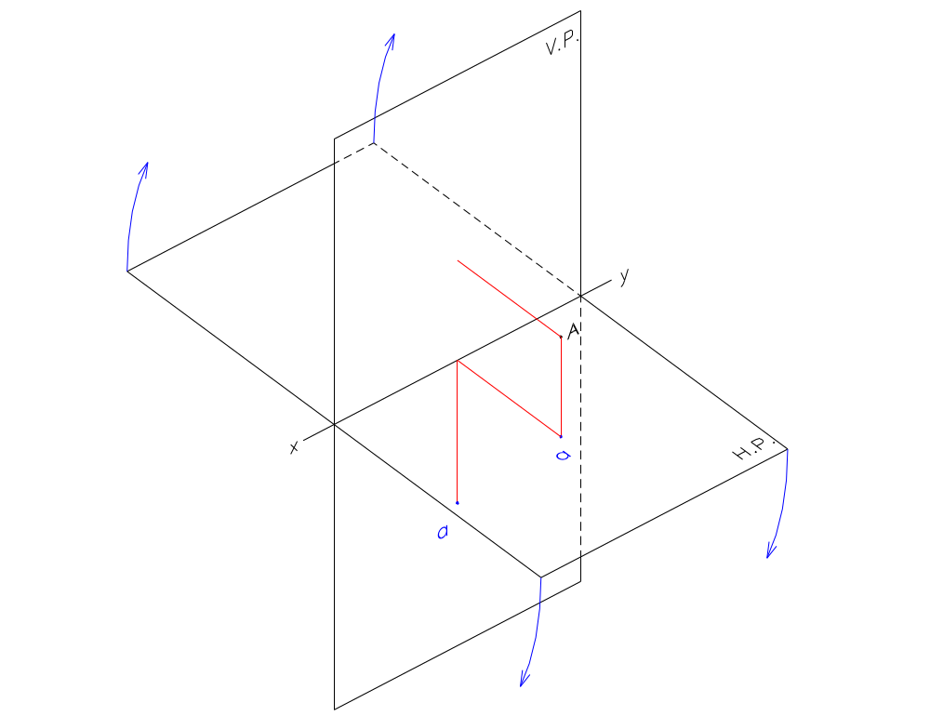
  Point In front of the V.P. and Above the H.P.
    Top View is drawn Below the xy.

Slide 31
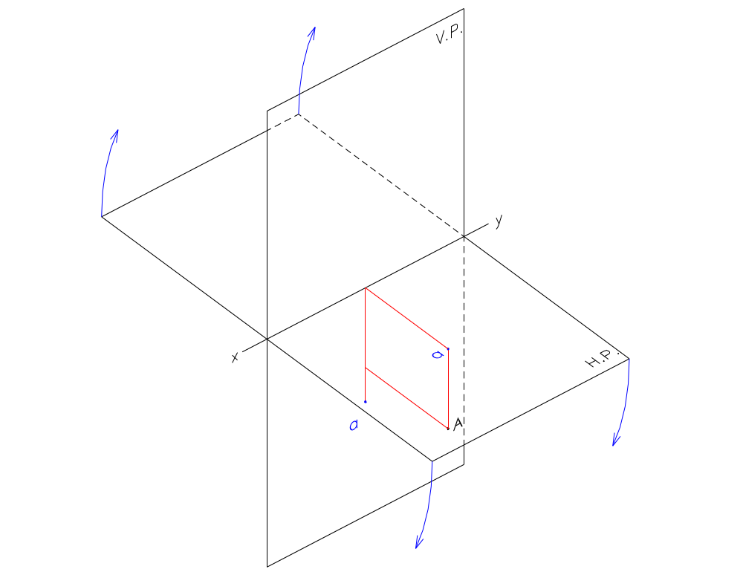
  Point In front of the V.P. and Below the H.P.
    Top View is drawn Below the xy.

Slide 32
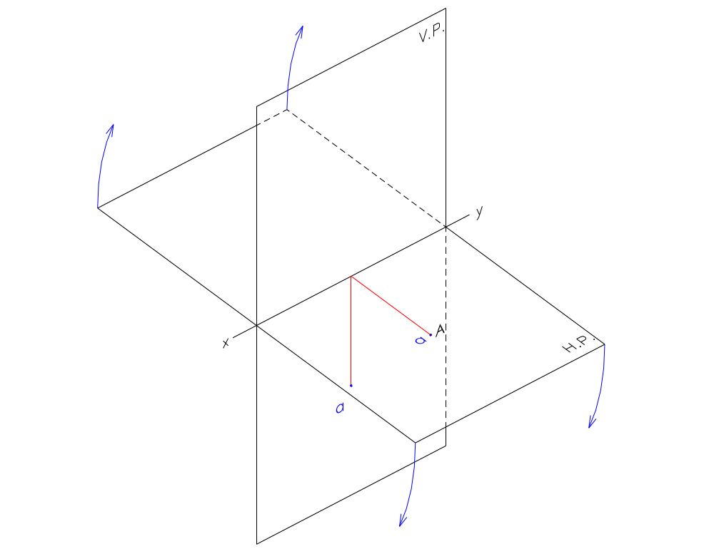
  Point In front of the V.P. and Within the H.P.
    Top View is drawn Below the xy.

Slide 33
If a point is IN FRONT of the V.P.;
Its Top View is always BELOW xy.

Slide 34
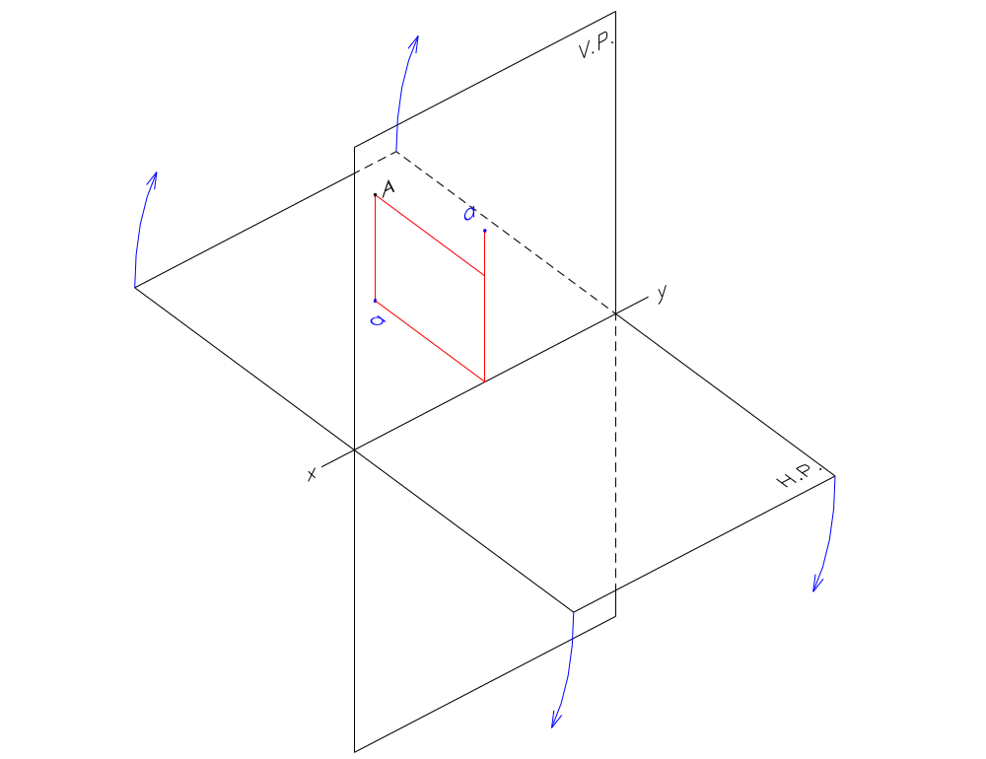
  Point Behind the V.P. and Above the H.P.
    Top View is drawn Above the xy.

Slide 35
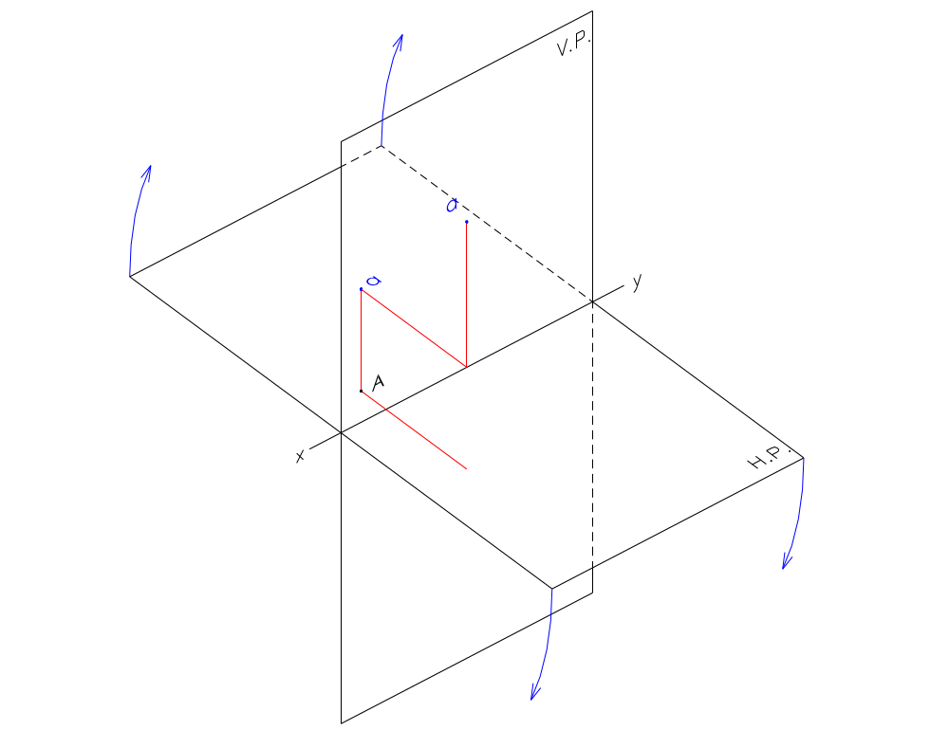
  Point Behind the V.P. and Below the H.P.
    Top View is drawn Above the xy.

Slide 36
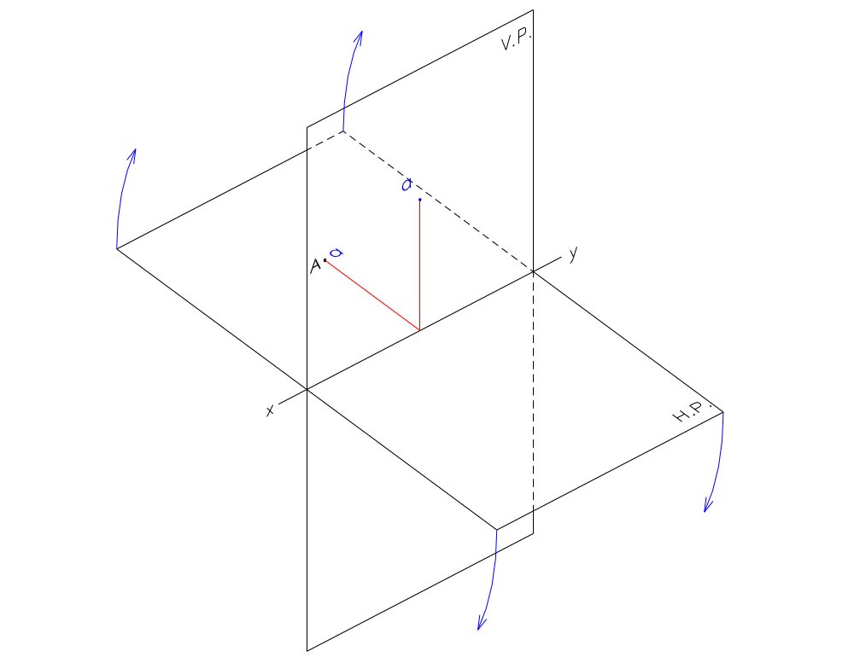
  Point Behind the V.P. and Within the H.P.
    Top View is drawn Above the xy.

Slide 37
If a point is BEHIND the V.P.;
Its Top View is always ABOVE xy.

Slide 38
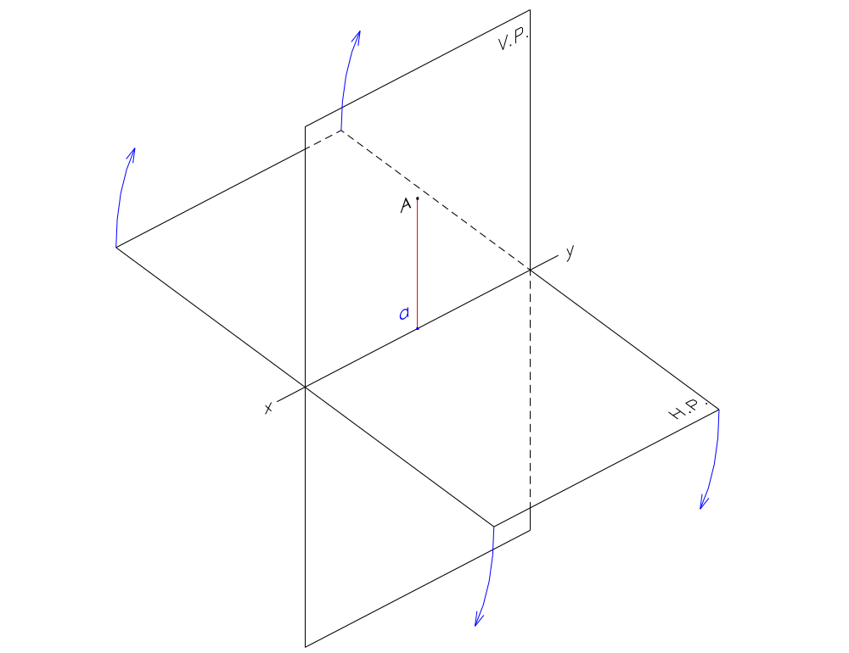
  Point Within the V.P. and Above the H.P.
    Top View is drawn In the xy.

Slide 39
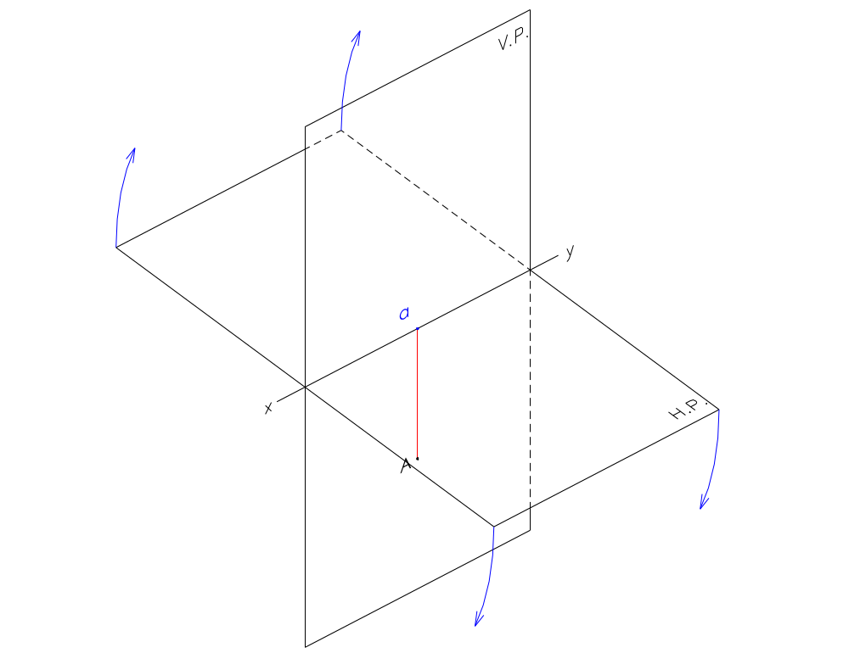
  Point Within the V.P. and Below the H.P.
    Top View is drawn In the xy.

Slide 40
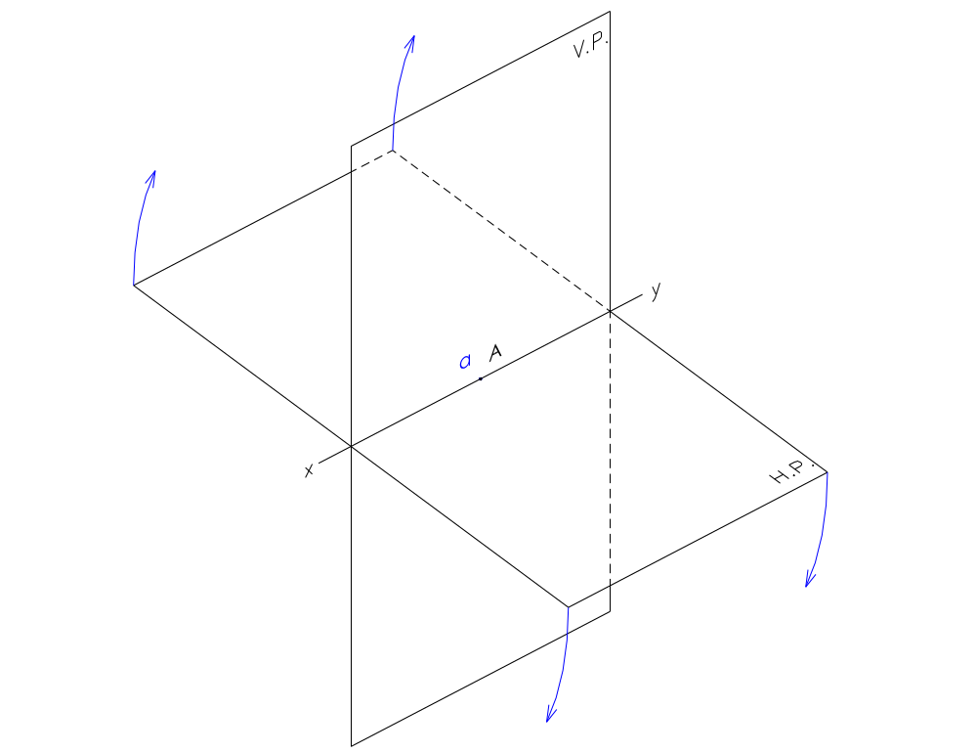
  Point Within the V.P. and Within the H.P.
    Top View is drawn In the xy.

Slide 41
If a point is WITHIN the V.P.;
Its Top View is always IN xy.

Slide 42
The position of the Top View of a point with respect to the xy line is dependent on its position with respect to the V.P. only.
The distance of the Top View of the point from the xy line is the same as the distance of the point from the V.P.

Slide 43
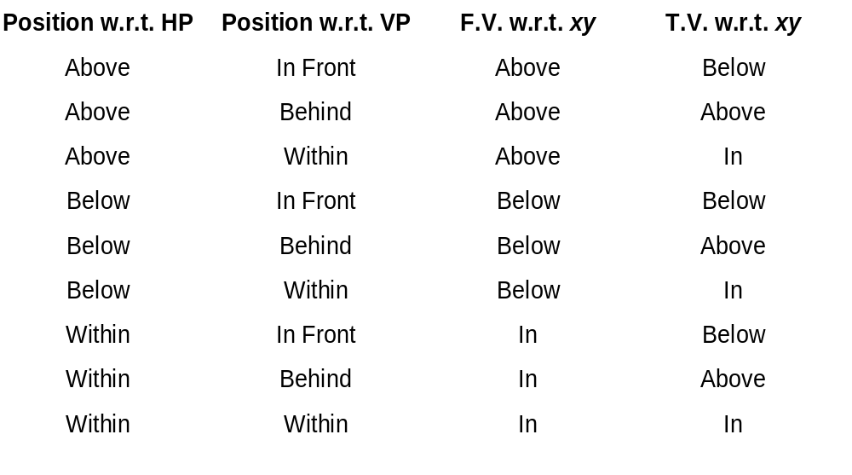

Slide 44
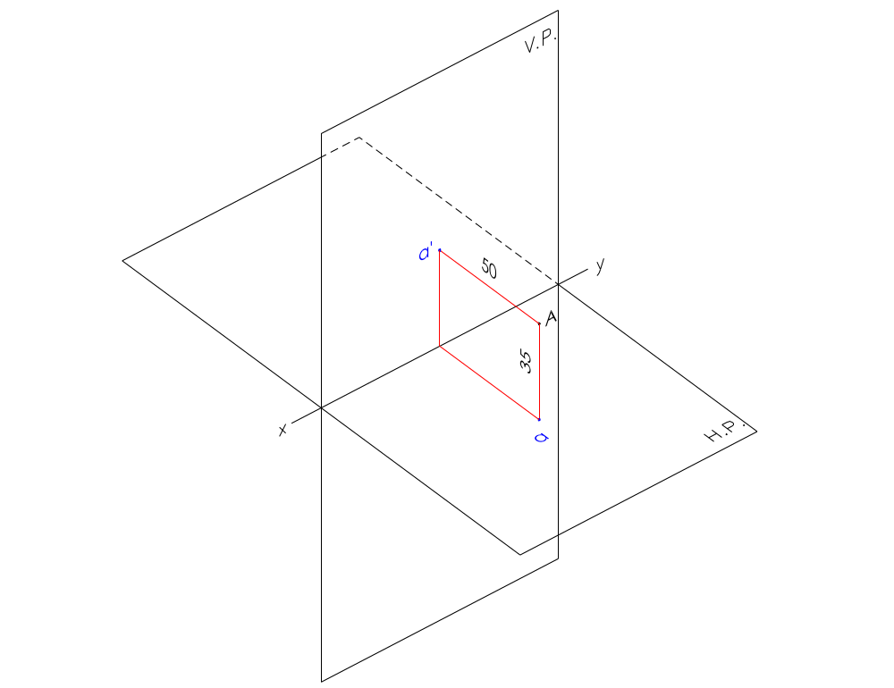
Example:
  A point ‘A’ is 35 mm above the H.P. and 50 mm in front of the V.P.

Slide 45
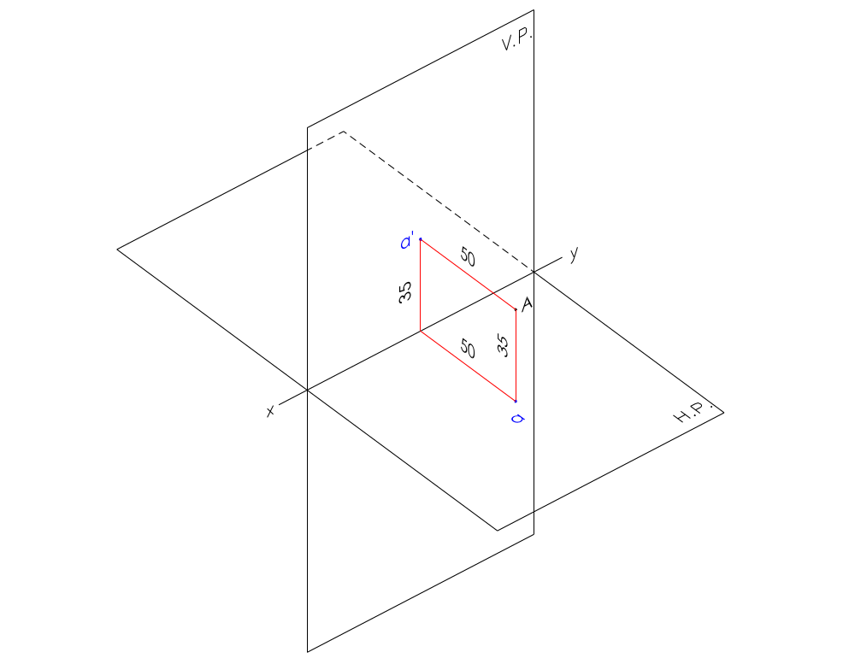
Example:
  A point ‘A’ is 35 mm above the H.P. and 50 mm in front of the V.P.

Slide 46
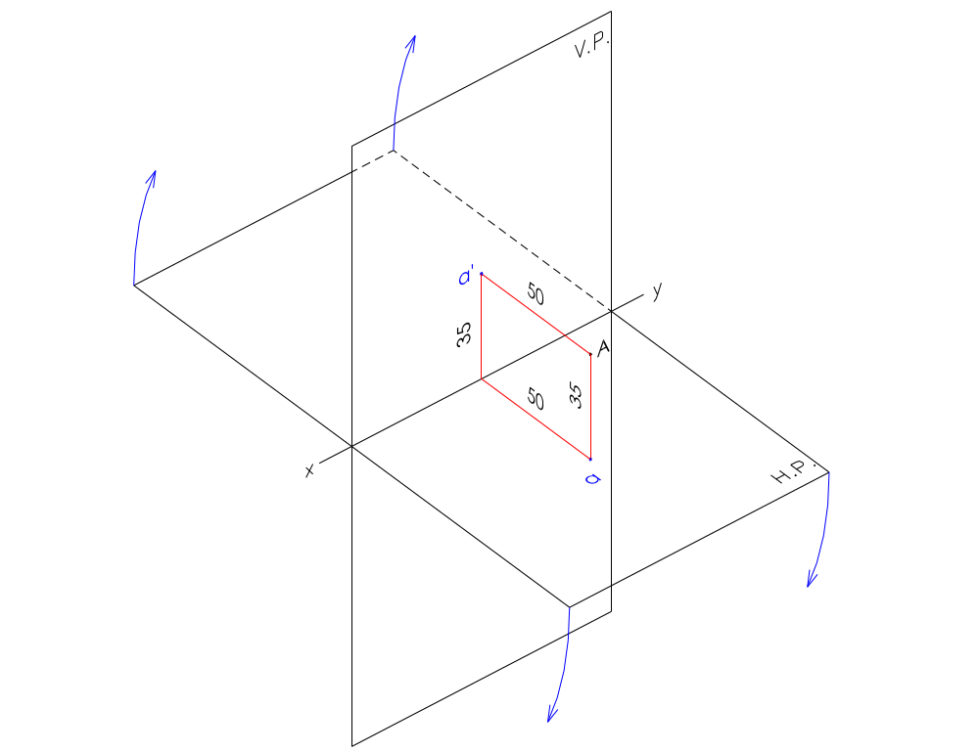
Example:
  A point ‘A’ is 35 mm above the H.P. and 50 mm in front of the V.P.

Slide 47
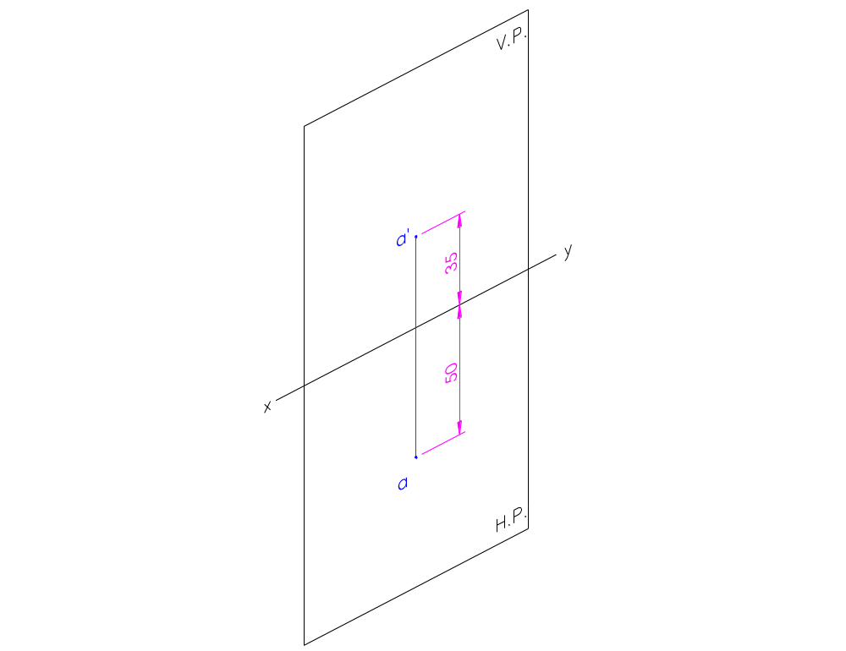
Example:
  A point ‘A’ is 35 mm above the H.P. and 50 mm in front of the V.P.

Slide 48
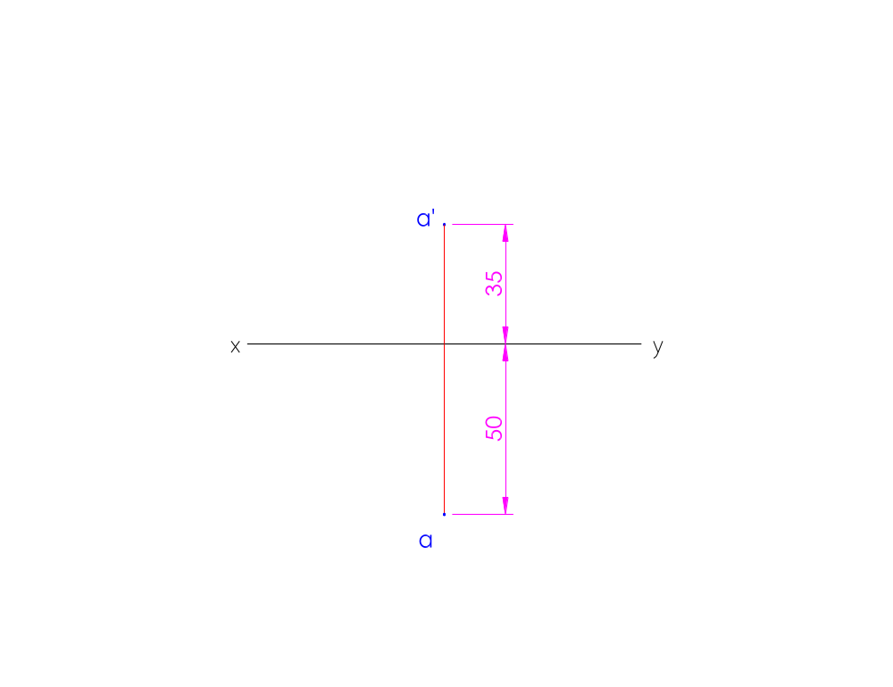
Example:
  A point ‘A’ is 35 mm above the H.P. and 50 mm in front of the V.P.

Slide 49
